Slide 1

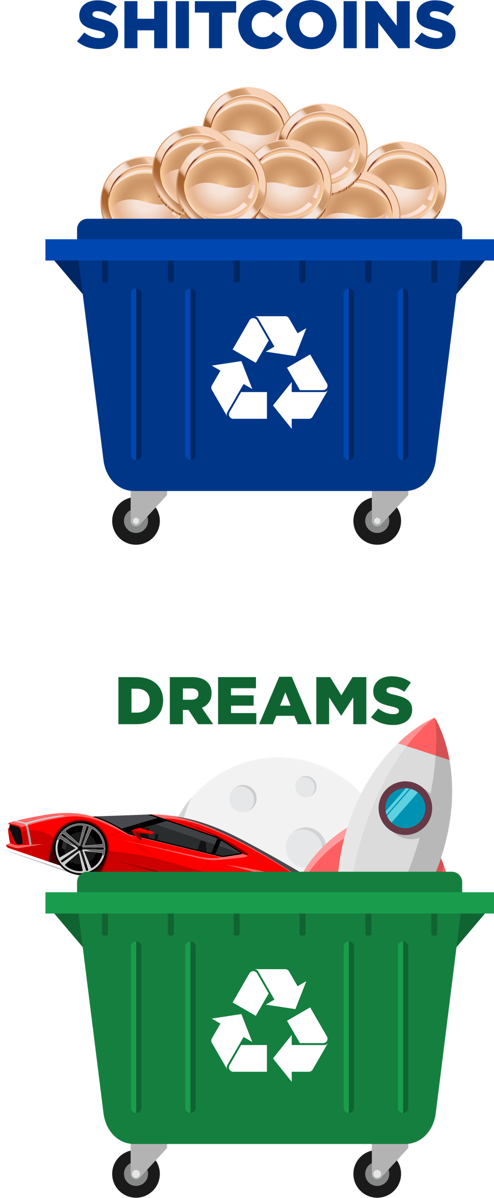
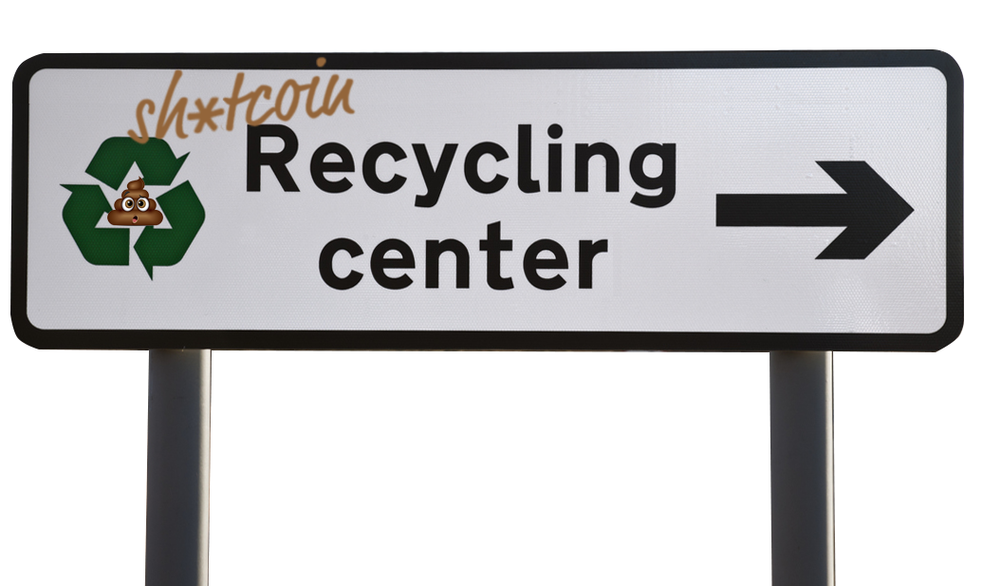
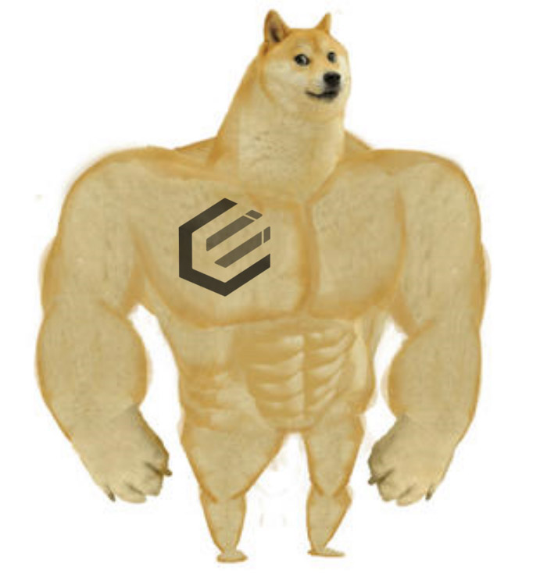

Sell or donate your failed dreams here.
Call Chad, the guy who puts the FUD in FUDFOMO today to get an instant quote in real cash money – Epic – today. If you accept my offer, I will set you up an atomic swap contract to execute the trade.
If we can’t buy your tokens, no one can.
No deal is too big or small.
Avoid costly congested chain fees by selling packages of coins together vs having to move money around.
WE PAY CASH
When an arbitrary quantity can be created there is nothing to stop those who control the printing from making more.
BUYING NOW | BUYING ALWAYS

